Slide 1
<CookItUp!>
Lucía Gutiérrez Molina
Inbal Hasson Tapiero
Alfonso Martínez Conejo
Javier Jordán Luque
Javier Zafra del Moral
Guillermo Pérez-Peña Martín
Lucía Corpas López
Jorge Velázquez Jiménez

Slide 2
Contents
Introduction
What We Offer
Planning
Teamwork
Requirements
Class Diagram
Sequence Diagram
Arquitecture
Environment
Testing
Database
Design Principles
Why “CookItUp!”?
Conclusion

Slide 3
Introduction
Problems we want to solve:
Low appreciation of people for the food period and the importance of a good meal.
Increased usage of precooked and fast food in society.
Urgent need for more internet sites that substitute these unhealthy habits.
Solution: Creating an app for sharing recipes with people all over the world.

Slide 4
What We Offer
Interact with other people
Be innovative
Express yourself
Test and experiment with new creations

Slide 5
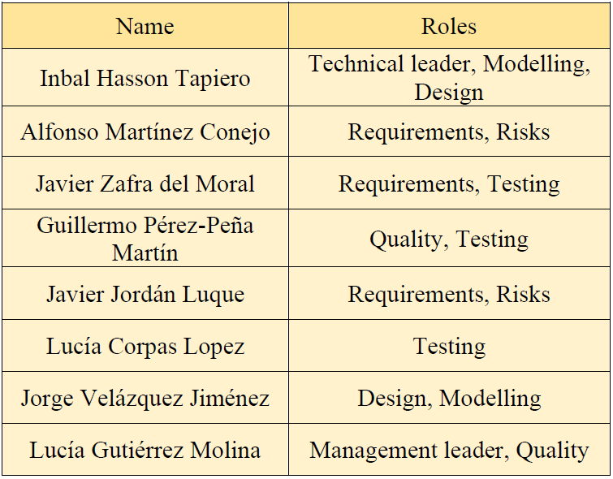
Planning
Roles Division

Slide 6

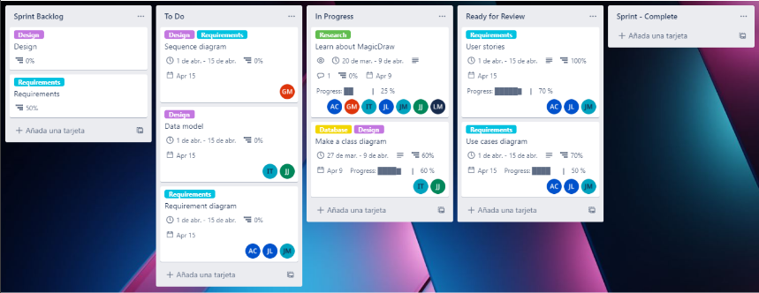
Planning

Slide 7
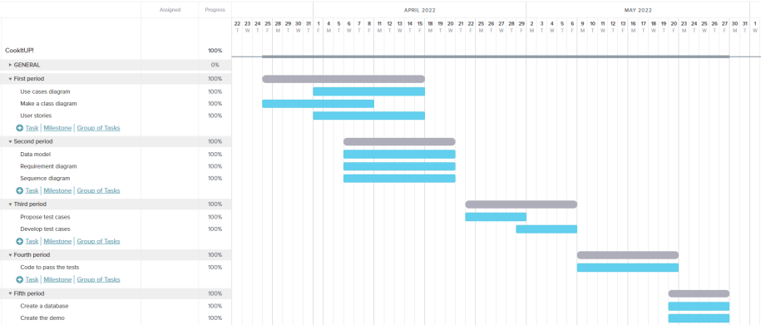
Planning
Gantt Chart

Slide 8
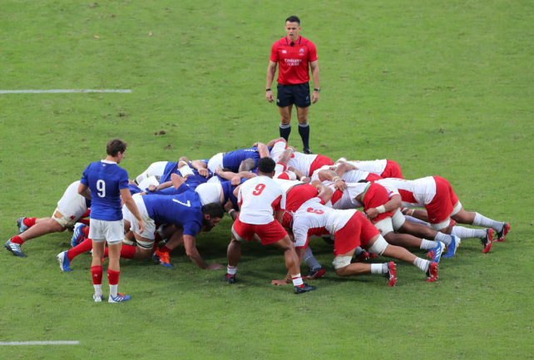
Planning
Agile Method: Scrum

Slide 9

Teamwork
Monday and Friday Meetings
Extra Online Meetings via Discord
Individual Reports per 2 Weeks

Slide 10
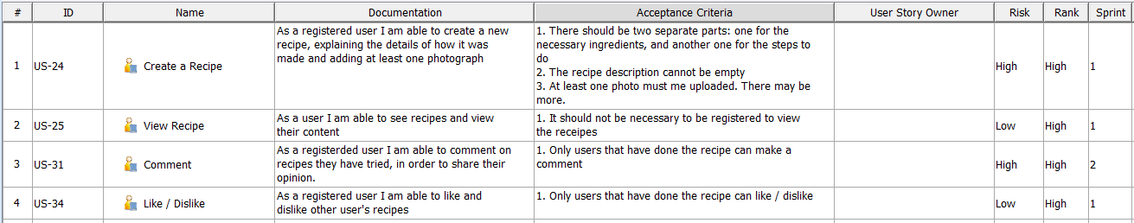
Requirements
User Stories
Some Examples:

Slide 11
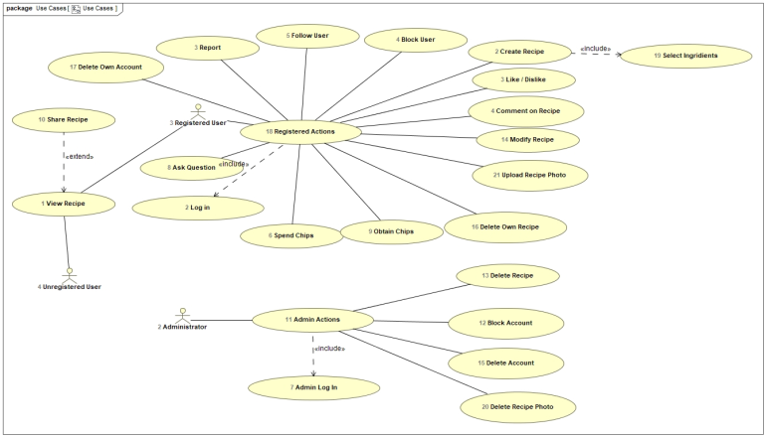
Requirements
Use Cases

Slide 12
Requirements
Functional Requirements
Create an account
Log in/out
Create/delete a recipe
Database for storage
View a recipe
Like/dislike a recipe
Comment/question
Share recipes
Gain coins
Report users
Delete own account
Block users
Follow users
Modify recipes

Slide 13
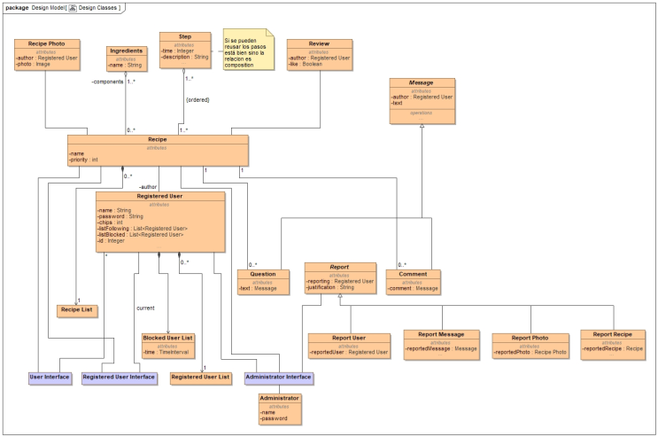
Class Diagram

Slide 14
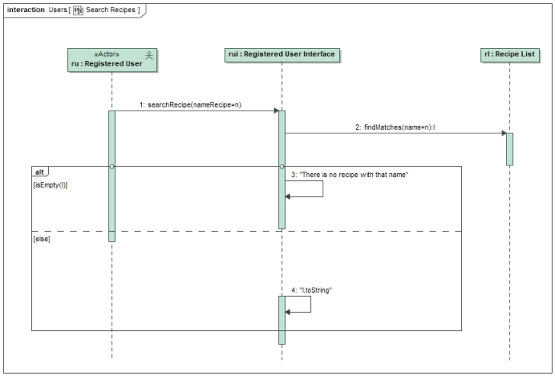
Sequence Diagram

Slide 15
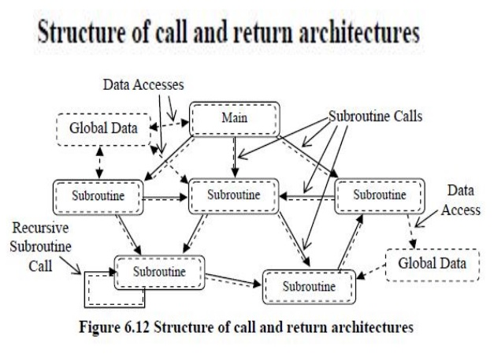
Architecture
Object-Oriented Call and Return

Slide 16


Environment
Java
Eclipse

Slide 17
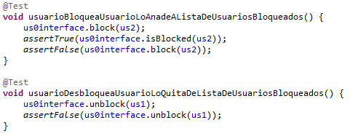
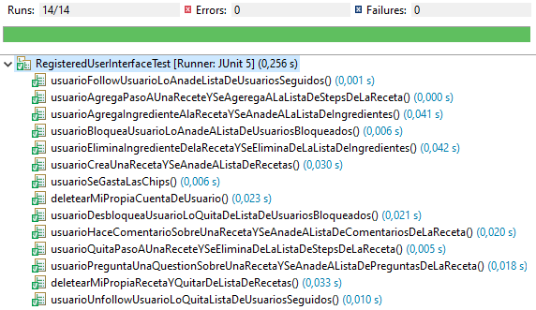
Testing
Test-Driven development
Junit 5

Slide 18
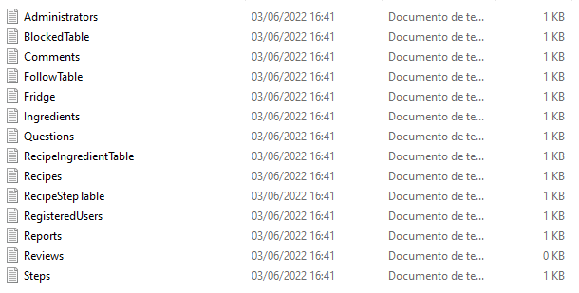
Database
Text Files

Slide 19
Design Principles
Modularity
Increase Cohesion
Reduce Coupling
Singularity
Interface Segregation

Slide 20
Why “CookItUp!”?
Young
Ambicious
Entertaining without addiction

Slide 21
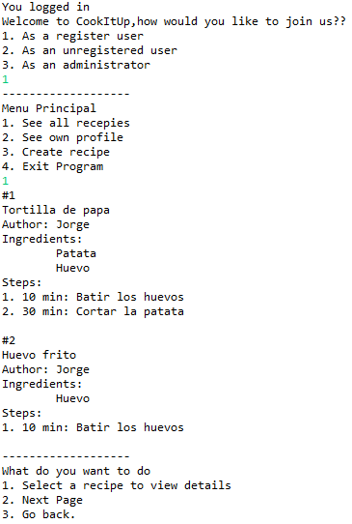
Results and Conclusion
Terminal Demo
What we have learned…
Teamwork
Responsability
Importance of schedule

